Slide 1


Ladder – A Hi-C Scaffolding Pipeline by Integrating Individual Assembly Packages
Zemin Ning
The Wellcome Sanger Institute
UK

Slide 2
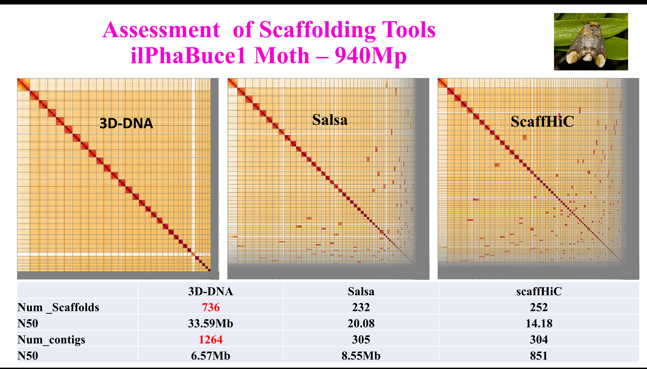

Slide 3
Ladder Pipeline - Flowchart
1. HiLine – Data processing: filtering, trimming and alignment of HiC reads
https://github.com/wtsi-hpag/HiLine
2. BreakHiC – Identifies contig breakpoints and removes errors at contig level
https://github.com/wtsi-hpag/scaffHiC
3. 3D-DNA – Genome scaffolding to get chromosome level structures
https://github.com/theaidenlab/3d-dna
4. Caus – Chromosome assignment using synteny: uses contigs from BreakHiC to replace sequences in the 3D-DNA assembly
https://github.com/wtsi-hpag/caus
5. ScaffHiC – Removes errors in scaffolds and make alternative joins with broken contigs
https://github.com/wtsi-hpag/scaffHiC
HiLine
BreakHiC
Primary Contigs
HiC Reads
3D-DNA
Caus
scaffHiC
Final Assembly

Slide 4
CAUS – Chromosome Assignment Using Synteny
Ctg 3
Ctg 3
3D-dna assembly
Ctg 2
Ctg 2
Ctg 1
Ctg 1
Primary contigs
Primary contigs
New chromosome

Slide 5
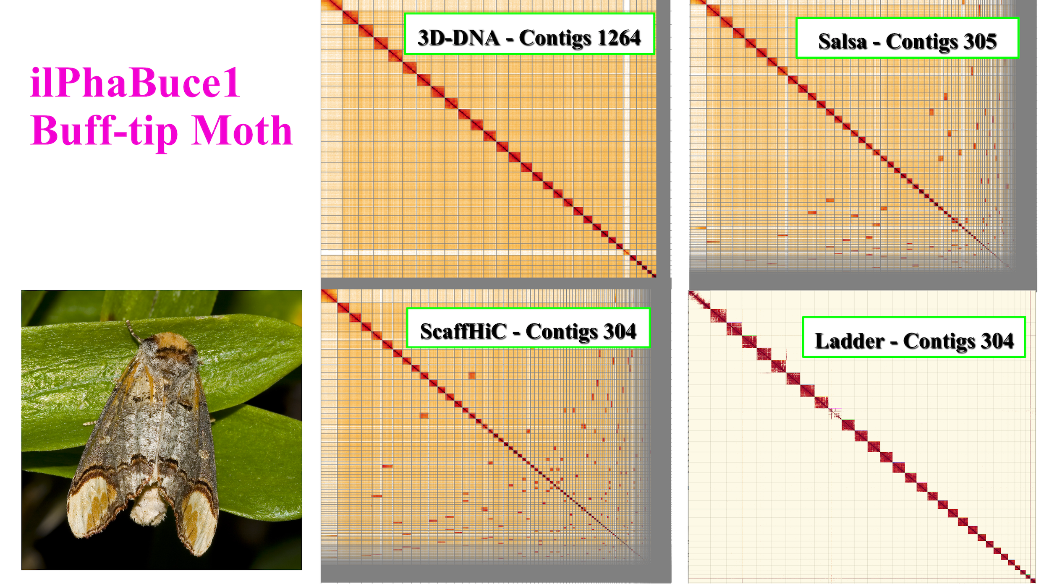

Slide 6
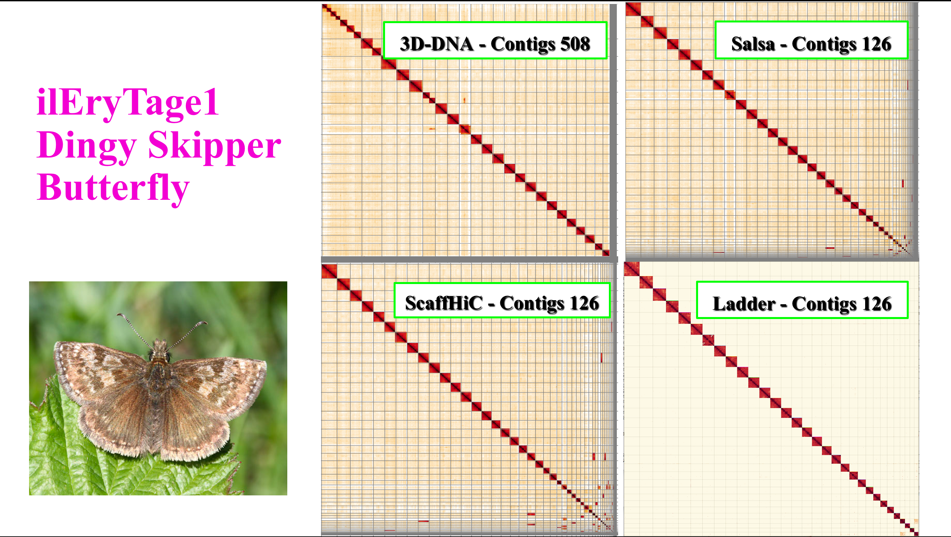

Slide 7
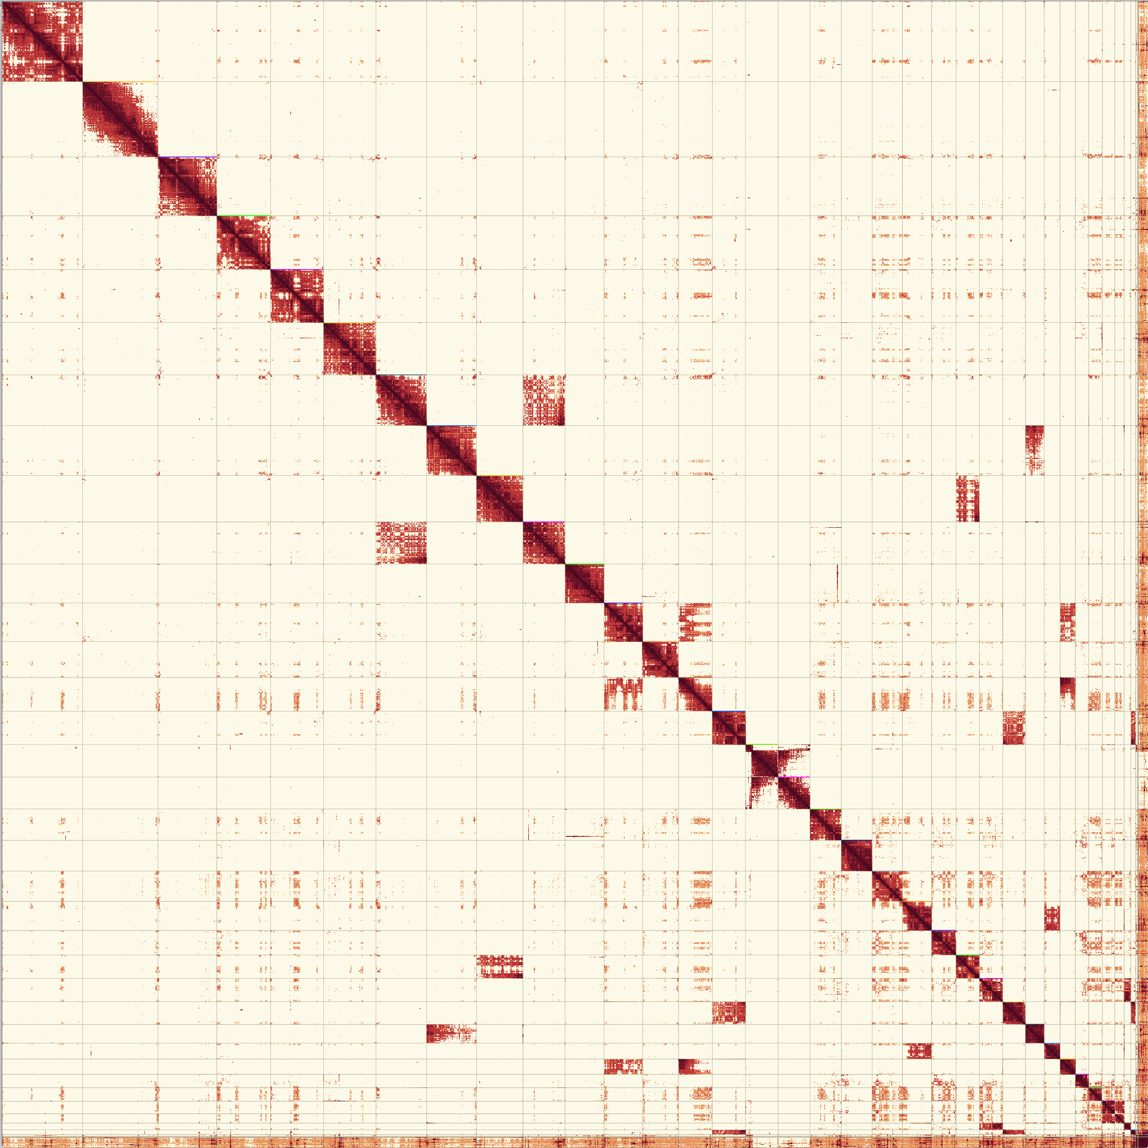
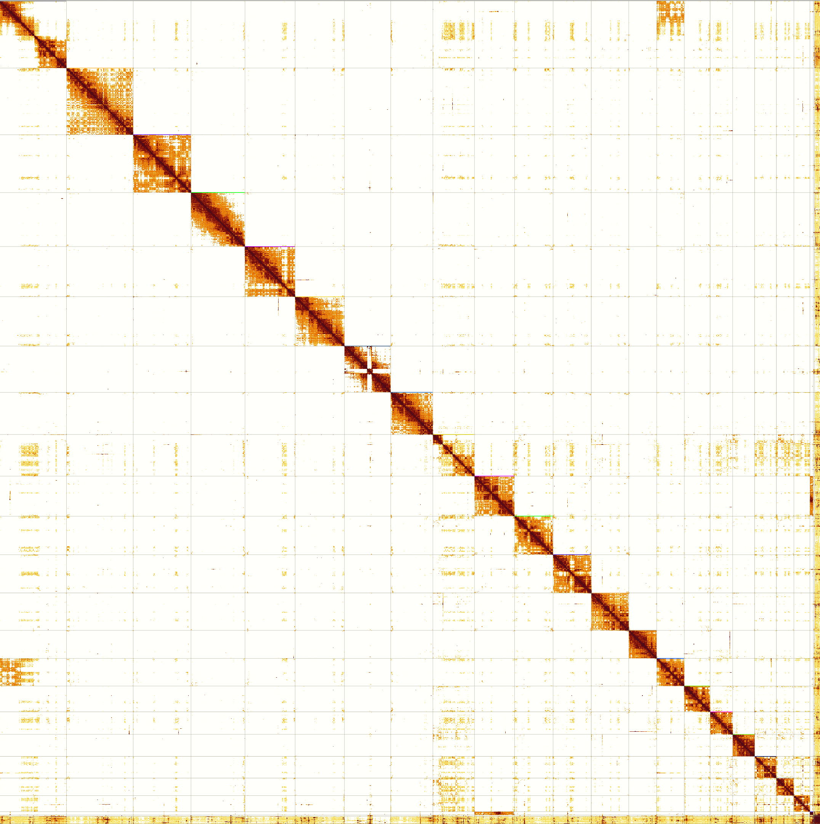
Human HG0002 Assembly
3D-DNA - Contigs 2718
Ladder – Contigs 2213

Slide 8





Acknowledgements:
Edward Harry
Kerstin Howe
Jo Wood
Marcela Uliano-Silva
Alan Tracy
Shane MaCarthy
Richard Durbin
Phase Genomics

